Slide 1
Invoice Data Extraction & Verification from Scanned PDFs
Sridharsan V
-22PT33

Slide 2
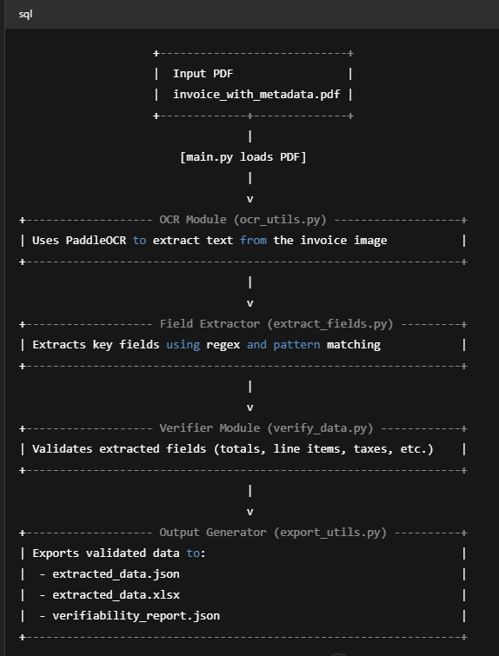
Architecture Overview:-

Slide 3
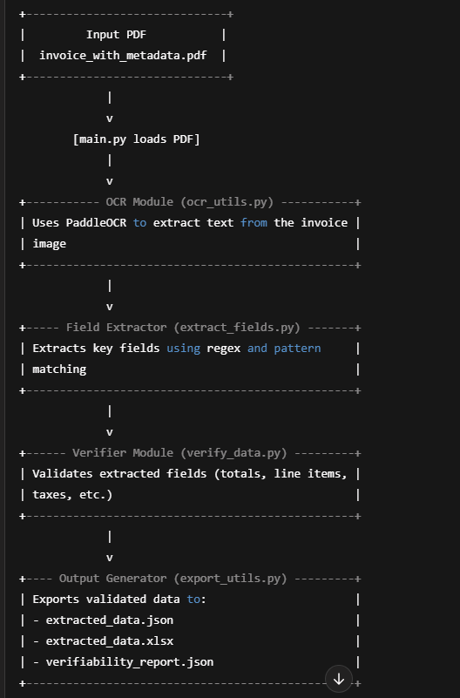
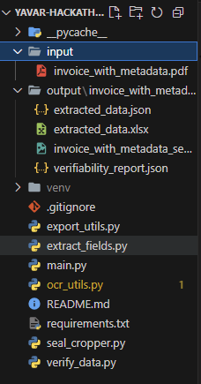
Flow chart and structure of the project :-

Slide 4
Approach to the problem :-
.
We adopt a modular OCR-based pipeline, powered by PaddleOCR, to extract invoice data with high accuracy, process it into structured formats, and validate its reliability.
Unlike Tesseract, PaddleOCR provides per-line confidence scores, allowing you to assess reliability for each field which was crucial for your verification and validation logic.
PaddleOCR is fast, runs on CPU or GPU, and doesn't require complex setup.
PaddleOCR delivers state-of-the-art text detection and recognition, especially for noisy, rotated, or scanned invoices and handles multi-font, multilingual, and skewed text far better than Tesseract.

Slide 5
Why Not Tesseract or Google Vision ?
PaddleOCR supports over 80 languages natively (including English, Hindi, Tamil, etc.), with excellent layout awareness and text alignment whereas google vision and Tesseract do not support much .
PaddleOCR is fully offline, open-source, and production-ready, ideal for privacy-sensitive and cost-efficient deployments but Tesseract is open-source but outdated in performance whereas Google vision is fully online and cloud based.
PaddleOCR provides detailed confidence scores per text segment and polygon-based positioning while others give the basic scores.

Slide 6
Steps Involved :-
Step 1 (PDF to Image Conversion):-
Each invoice PDF is converted into image pages using pdf2image.
Enables OCR processing page-wise.

Slide 7
Step 2 (Text Detection & Recognition using PaddleOCR):-
PaddleOCR detects:
Text Regions using bounding boxes (polygons)
Recognized Text for each region
Confidence Score per region
The result is structured:
rec_texts, rec_scores, rec_polys
✅ Why this matters: Confidence scores and positions are used for downstream accuracy and verifiability.

Slide 8
Step 3 (Field Extraction with Keyword Mapping):-
Fields like:
Invoice Number, Invoice Date, GST, Shipping Address, etc.
Approach:
Keyword-based scanning across all OCR results.
Proximity or next-line text after a keyword (e.g., Invoice No:).
✅ Accuracy Boost: Matches are filtered with confidence ≥ 0.85 ✅ Fallback Logic: If no direct match, search for nearby or subsequent line.

Slide 9
Step 4 (Line Item / Table Extraction):-
A flat list of all OCR lines is created.
The script scans for expected headers like:
description, quantity, unit_price, etc.
Once headers are found, rows are extracted in fixed-length blocks (e.g., 7 lines per row).
✅ Accuracy Handling:
Validates each field per row.
Skips junk data or extra lines.
Produces a clean tabular structure of line items.

Slide 10
Step 5(Verifiability Logic):-
Field-Level Verification:
Each extracted field is tagged with:
value, confidence, and present: true/false.
Flags fields with:
Low confidence (< 0.85)
Missing value
Line Items Verification:
Verifies calculated total = quantity × unit_price
Compares with extracted "total" field.
Flags mismatch > 0.1 margin.
Overall Totals Check:
Uses extracted values for:
subtotal, discount, gst, final_total
Recomputes expected total and compares with extracted total.

Slide 11
Step 6 (Output Generation):-
Three outputs per invoice:
extracted_data.json – All structured data
extracted_data.xlsx – Tabular line items
verifiability_report.json – Confidence and consistency checks

Slide 12
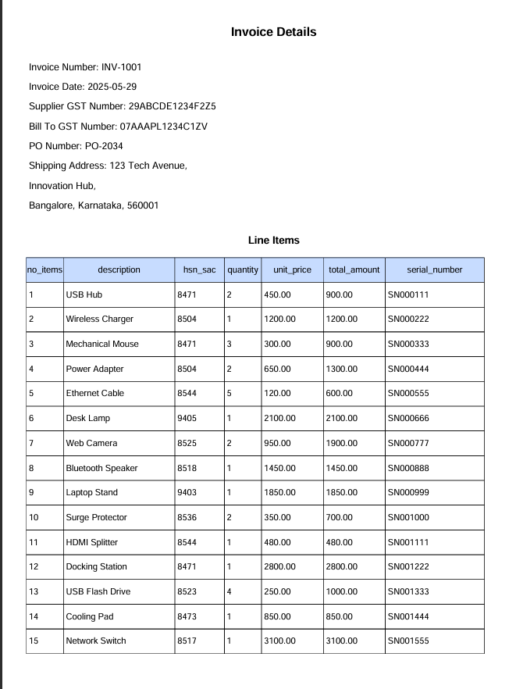
Input Invoice:-

Slide 13
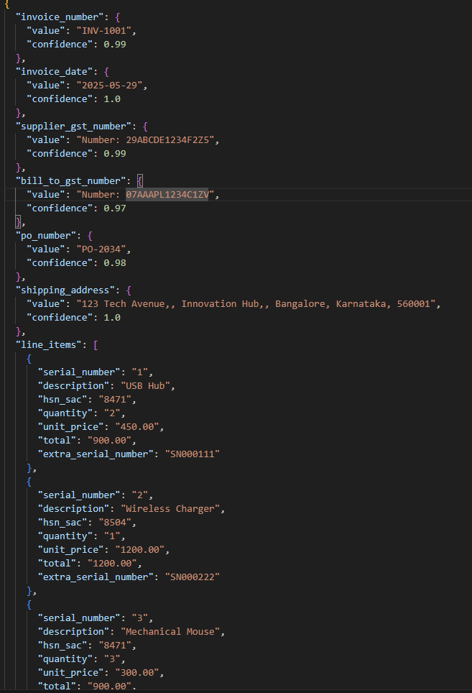
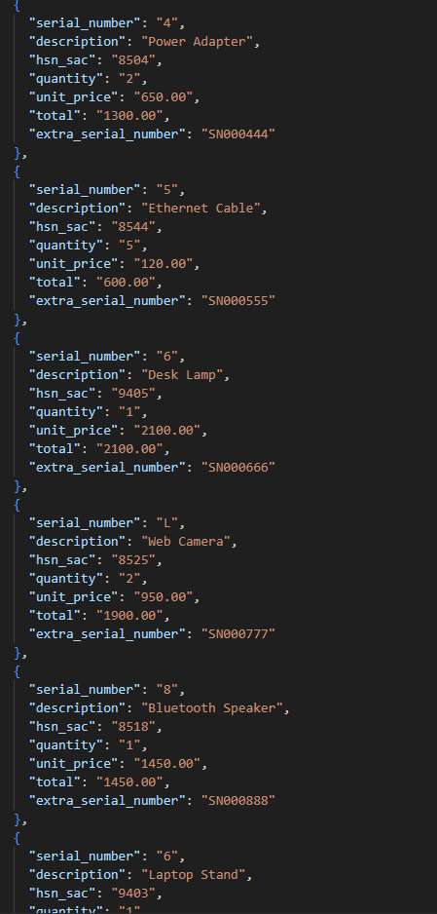
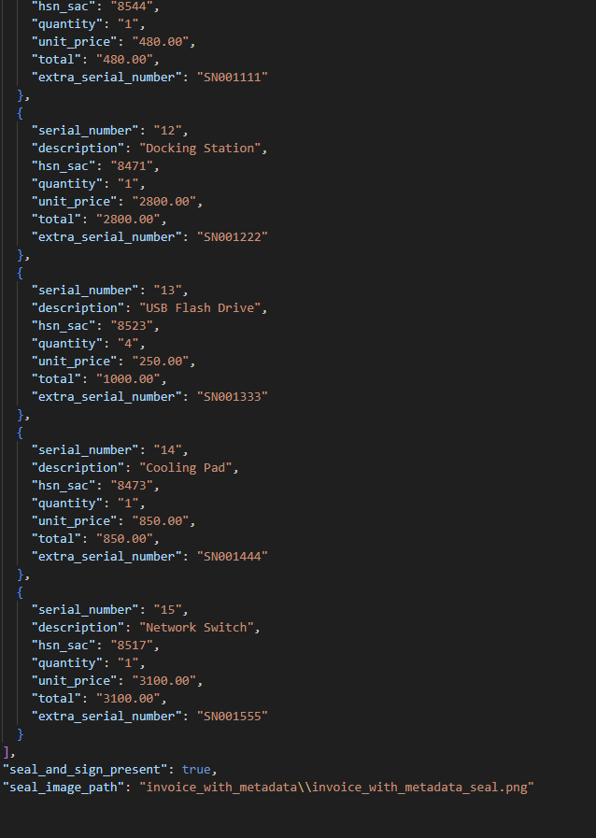
Output 1:Extracted_data.json

Slide 14
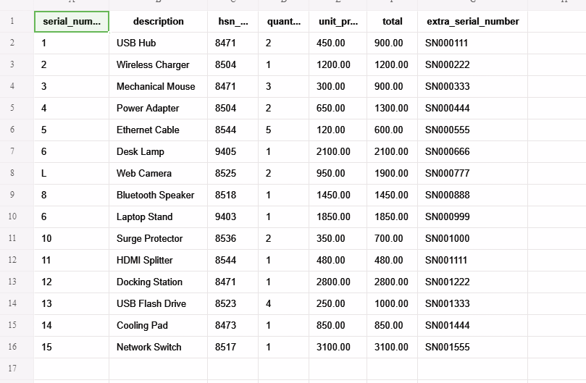
Output 2:extracted_data.xlsx

Slide 15
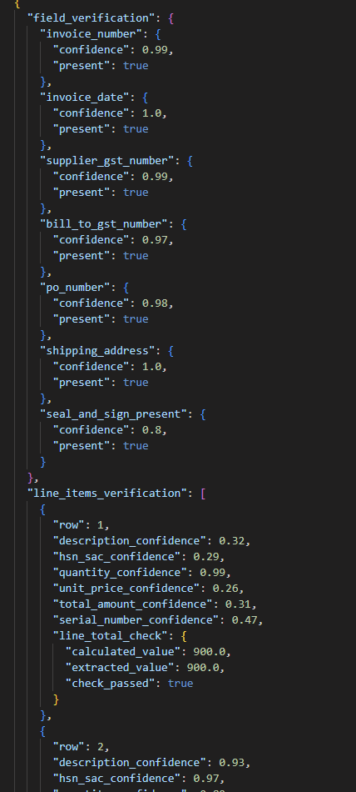
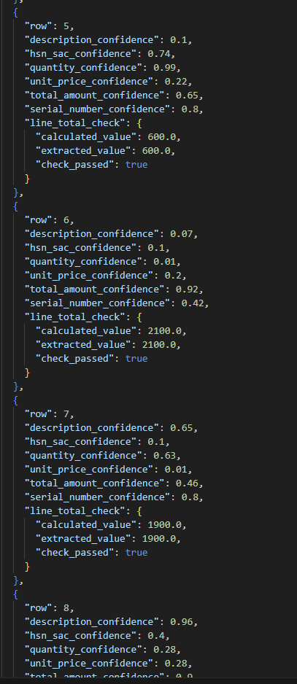
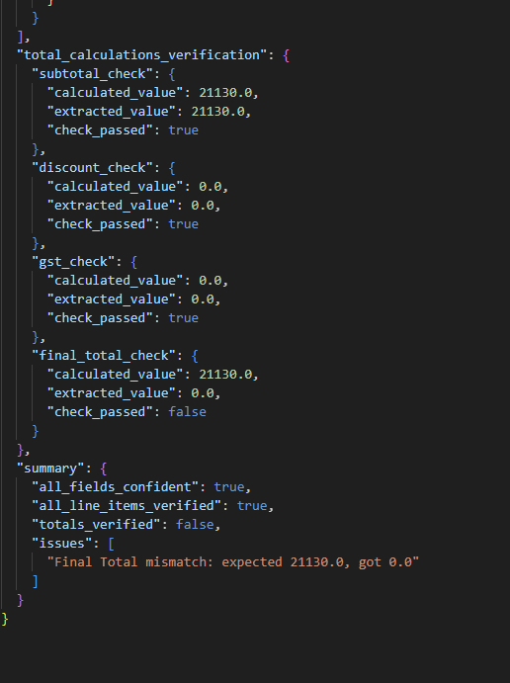
Output 3:Verifiability_report.json

Slide 16
Future improvements:-
Develop a User Interface (UI) for Invoice Upload and Review Build a Streamlit-based (or web-based) UI where users can upload invoices, view extracted fields (like vendor name, invoice number, totals, and tables), verify or edit fields, and download structured outputs in JSON or Excel format.
Enhance the Invoice Processor for Broader Format Coverage Upgrade the field extraction and table parsing logic to handle a wide variety of invoice formats across different languages, layouts, and orientations. This may include using layout-aware models (like LayoutLMv3 or Donut), rule learning from labeled examples, or self-improving heuristics.
Implement Feedback-Driven Model Fine-Tuning Allow users to correct extracted fields in the UI, then store those corrections to gradually fine-tune or adapt the model using active learning. This helps improve accuracy over time without needing fully annotated training datasets.

